Slide 1
History
Mt Tehama composite volcano built 600,000 to 400,000 years ago
Mt Tehama collapse(?) and erosion
Domes, glaciers and more domes
Most recent activity 1914-1917
Notes:
Before the 1980 eruption of Mt. Saint Helens, Lassen Peak was the only Cascadian volcano to erupt in the last century. The eruptions, which occurred between 1914 and 1917, were well documented and should not be forgotten, as they warn of the diverse and deadly hazards presented by Cascadian volcanoes.

Slide 2
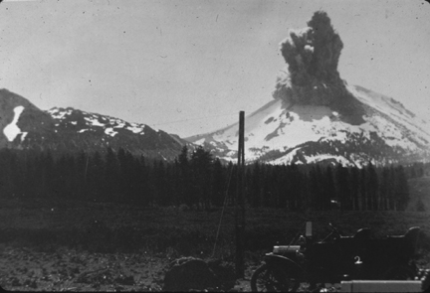
June 14, 1914 One of more than 150 steam-blast (phreatic) eruptions
Notes:
Lassen Peak sprang to life on May 30, 1914, when a small phreatic eruption occurred at a new vent near the summit of the peak. More than 150 similar explosions of various sizes occurred during the following year. This early phase of phreatic or steam-blast eruptions erupted no new magma, but ejected only finely broken rock fragments as it excavated a crater in the 27,000-year-old Lassen Peak volcanic dome. These eruptions occurred as water (largely from melted snow), seeped into fractures in the dome produced by the forceful intrusion of magma at depth. Since the rock exposed along the newly created fractures was extremely hot due to the proximity of the rising magma, the sinking water quickly turned to steam, which blasted out fragments of the fractured dome.

Slide 3
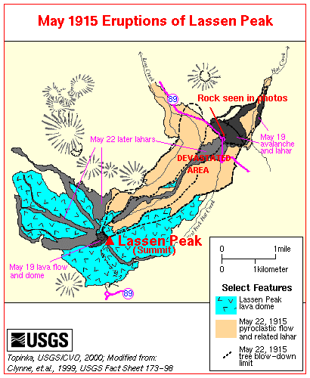
Notes:
By mid-May 1915, the eruption changed in character; lava appeared in the summit crater …

Slide 4
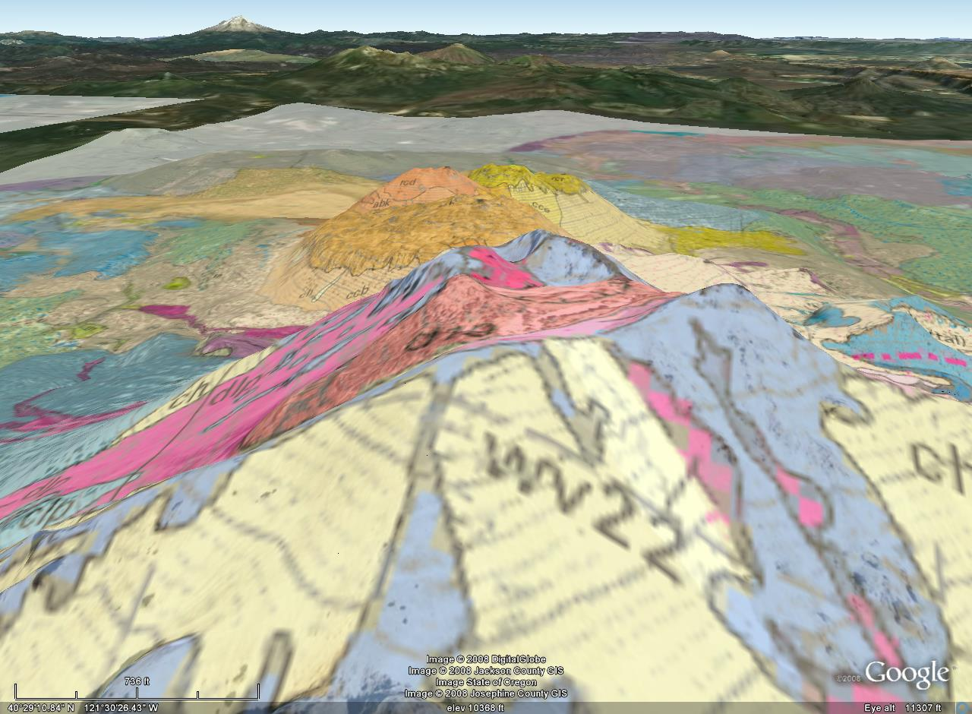
May 14th dome
May 19th flow
Notes:
… first as a small dome on May 14, but shortly thereafter as a flow which spilled about 100 m over the west and probably over the east crater walls.

Slide 5
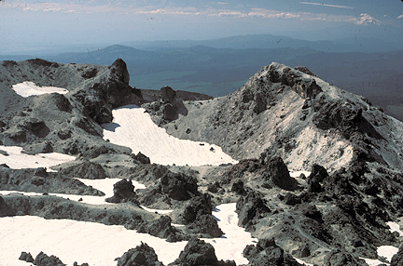
May 19th flow
Notes:
Disruption of the blocky, viscous lava on the upper east side of Lassen Peak on May 19 resulted in an avalanche of hot rock onto a snowfield.

Slide 6
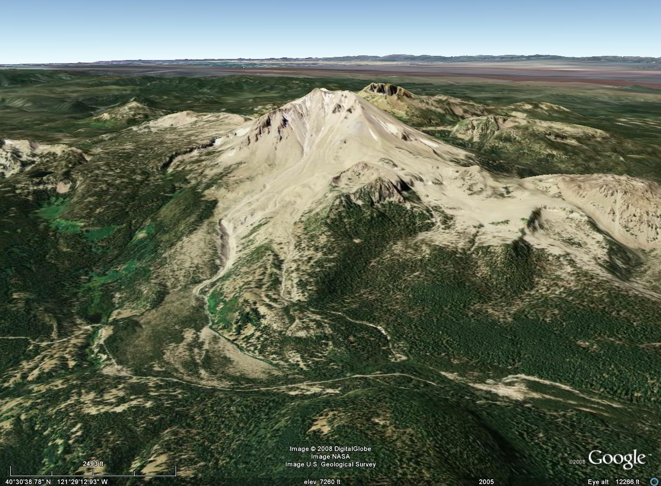
approximate lahar path
Notes:
A lahar was generated that reached more than 18 km down Lost Creek.

Slide 7
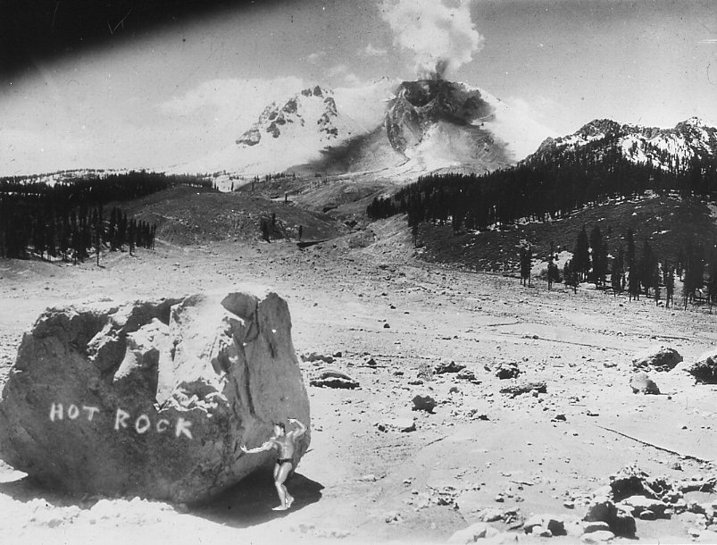
Great mud flow and flood from May 19, 1915 eruption
Notes:
The great avalanche and mud flow which accompanied the eruption of May 19, 1915 devastated a previously forested area and buried it under volcanic debris including the large rock in foreground. California law mandates that for scale, all depictions of this rock be accompanied by a photo of Arnold Schwarzenegger during his prime “Mr. Universe” years. Labeled "HOT ROCK" by the photographer, the rock is a piece of the lava dome which grew in the crater of Lassen Peak between May 14 and 19 and was fragmented by a volcanic explosion that reopened the crater and initiated the avalanche and mudflow.

Slide 8
Photo taken during the morning of May 22, 1915
Notes:
Since this photo was taken on the morning of May 22, 1915 and the rock had only formed a few days earlier, it was no doubt very hot when the photographer took the picture. If you look closely near the summit of Lassen Peak, just below and left of the steam cloud, you can see a portion of the glassy black dacite flow of May 19, 1915. It’s a good thing the photographer left the scene, because late in the afternoon of that same day he’d surely have died when …

Slide 9
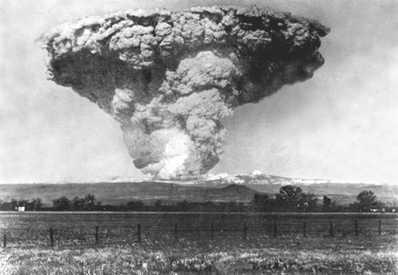
May 22, 1915 late afternoon
Notes:
… this happened. After two quiet days, Lassen Peak exploded in a powerful eruption that blasted rock fragments and pumice high into the air, creating the larger and deeper of the two craters seen near the summit of the volcano today.

Slide 10
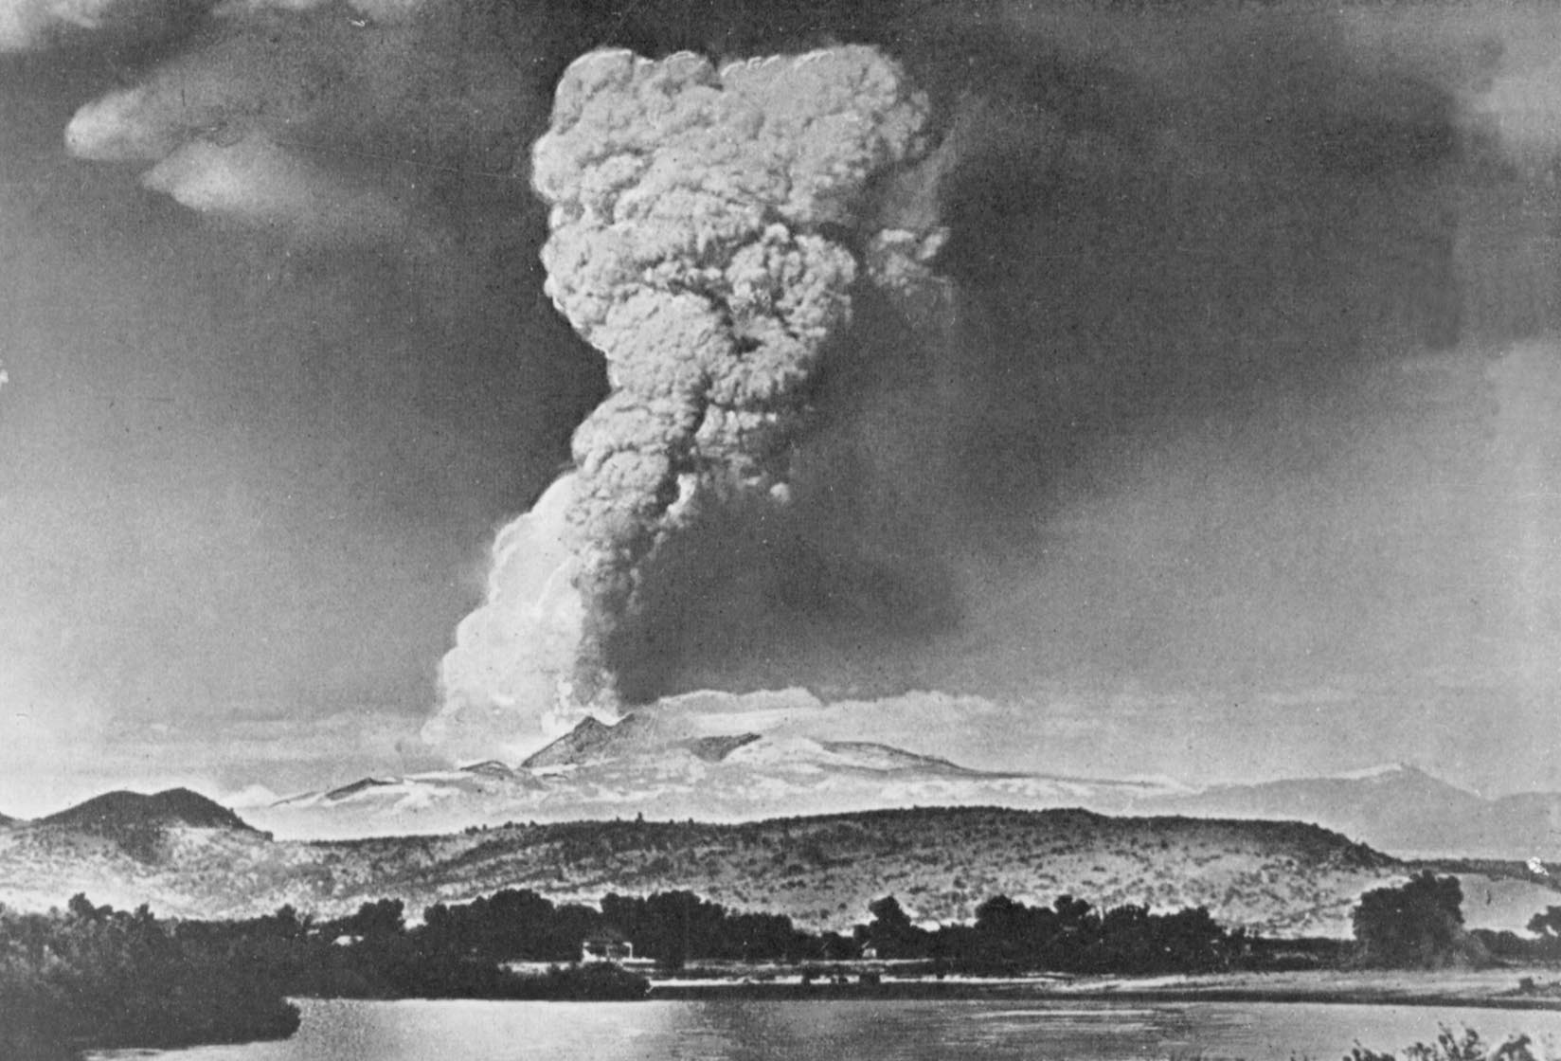
Notes:
A huge column of volcanic ash and gas rained fine volcanic ash as far away as Winnemucca, Nevada, 200 miles to the east. In this photograph taken from near the town of Red Bluff, 40 miles west of the volcano, the huge column of volcanic ash and gas produced by the eruption rises to a height of more than 30,000 feet.

Slide 11
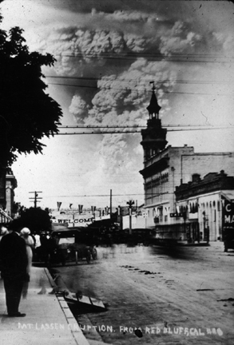
Notes:
The eruption was one of the first to be thoroughly photographed. Here we see it from the main street of Red Bluff, California, in the Sacramento Valley.

Slide 12
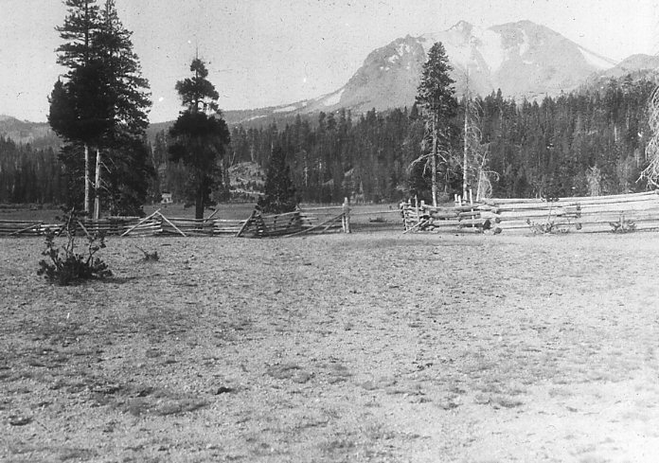
Before 1915 mud and pyroclastic flows
Notes:
Pumice falling onto the northeastern slope of Lassen Peak generated a high-speed avalanche of hot ash, pumice, rock fragments, and gas, called a pyroclastic flow, that swept down the side of the volcano, …

Slide 13
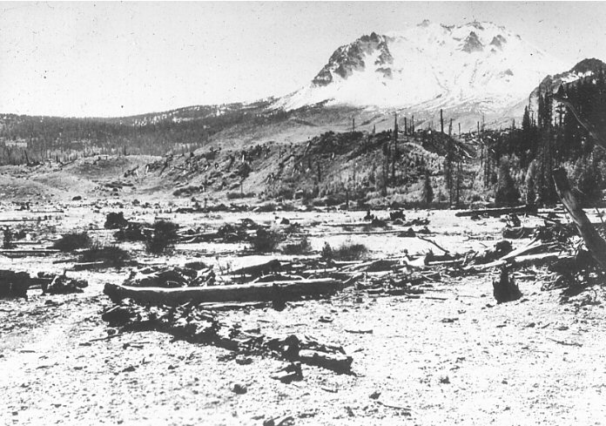
After 1915 mud and pyroclastic flows
Notes:
… devastating a 3-square-mile area. The pyroclastic flow rapidly incorporated and melted snow in its path. The water from the melted snow transformed the flow into a highly fluid lahar that followed the path of the May 19-20 lahar and flooded lower Hat Creek Valley a second time.

Slide 14
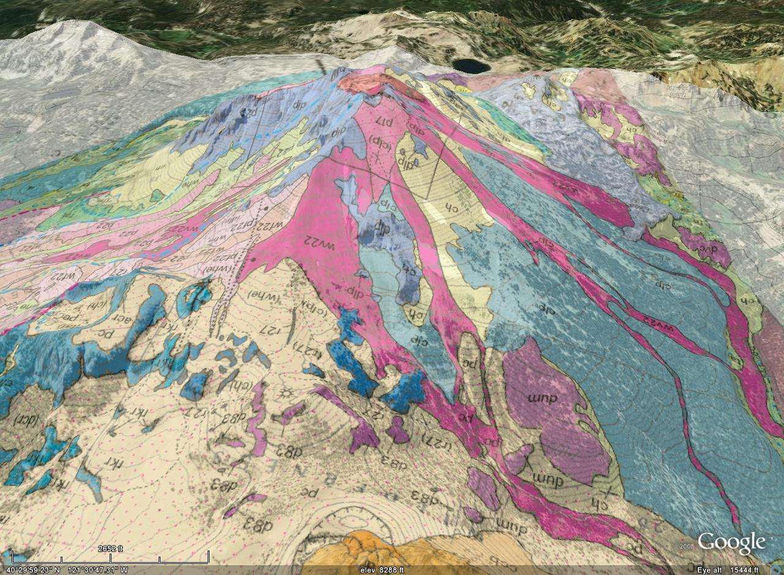
May 19th lava flow removed
Mudflows
Notes:
The powerful climactic eruption of May 22 also swept away the northeast lobe of the lava flow extruded 2 days earlier and produced smaller mudflows on all flanks of Lassen Peak.

Slide 15
Mud flow and flood from May 19, 1915 eruption
I’ll be back.
Notes:
If you compare this pre-pyroclastic flow photo …

Slide 16
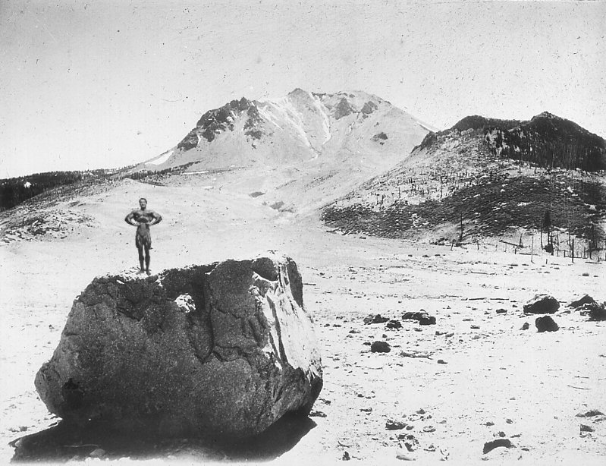
After horizontal blast and pyroclastic flow
I told you I’d be back.
Notes:
… to this one taken after the horizontal blast and pyroclastic flow of the cataclysmic May 22, 1915 eruption, you can see that much of timber shown in preceding view was leveled. (This photo is compliant with all laws of the great State of California.)

Slide 17
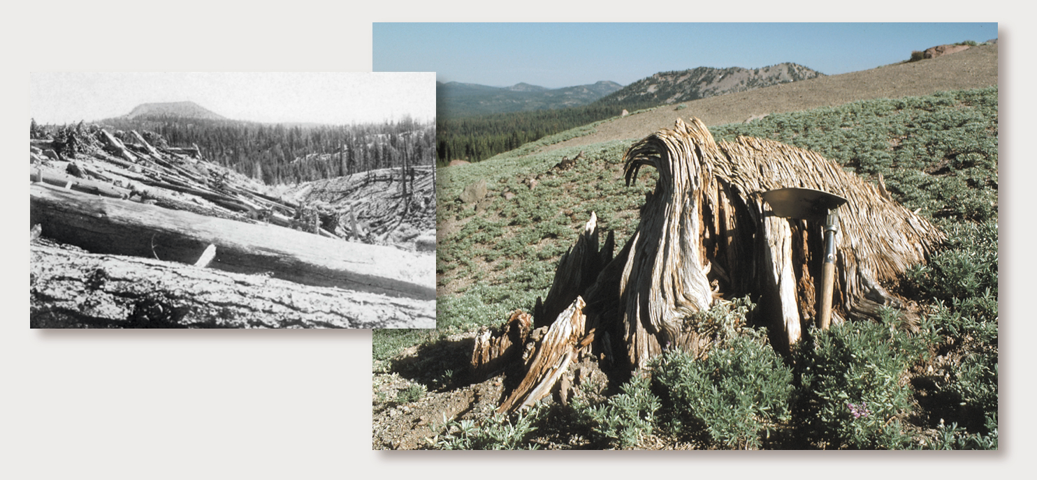
Notes:
The horrific force of the blast is eerily apparent from the vast number of trees felled as well as from their twisted trunks.

Slide 18
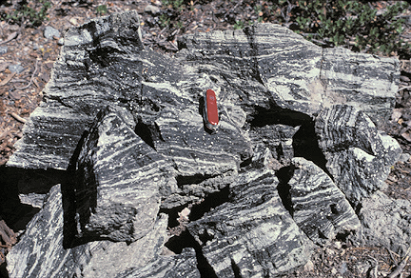
Notes:
The power of the cataclysmic eruption may be related to the combining of magma masses of two different compositions. The striking color banding in this block of banded andesite-dacite pumice from the May 22, 1915 eruption reflects the mingling of two compositional varieties of erupted magma, contorted by flowage of the incompletely mixed viscous liquids.

Slide 19
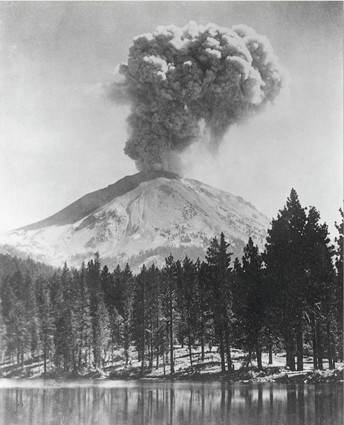
October 1915
Notes:
Intermittent eruptions of variable intensity continued until about the middle of 1917, but Lassen has been relatively quiet ever since.

Slide 20
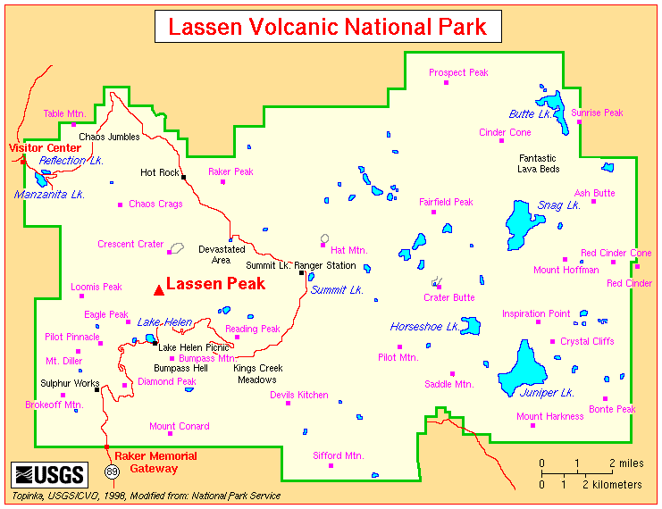
Fumaroles, mud pots, and hot springs
Notes:
Nonetheless, vestiges of Lassen’s volcanic glory days live on in three notable hydrothermal areas: The fumaroles of the Sulphur Works, mud pots of Bumpass Hell, and hot springs of Devils Kitchen.

Slide 21
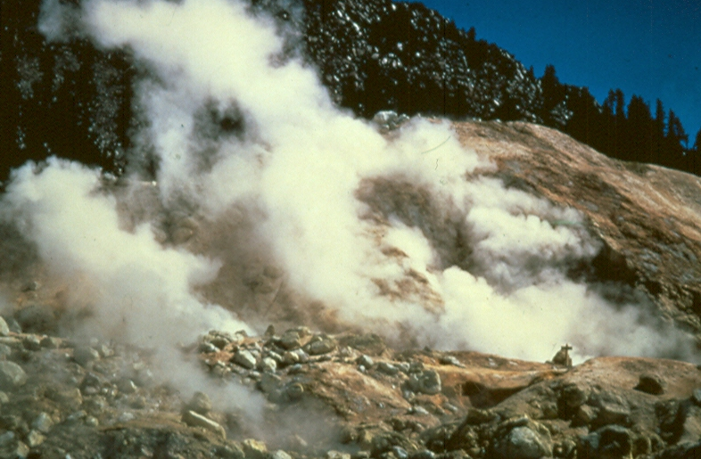
Sulphur Works
Notes:
The Sulphur Works [sic] is thought to be part of the central vent system of ancient Mount Tehama. Here sputtering hot springs, steaming fumaroles and hot bubbling mud pots are fed sulfur compounds released from the crystallization of magma below ancient Mt. Tehama. Sulfur compounds react with the heated groundwater to form sulfurous or sulfuric acid which are highly corrosive and alter the volcanic rocks into various clay minerals.

Slide 22
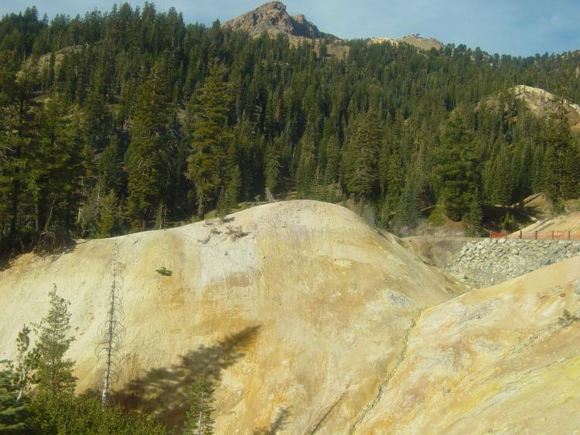
Sulphur Works
Notes:
The archaic spelling of the name Sulphur Works dates back to in 1865, when efforts were made to develop the sulfur and clay potential of the area.

Slide 23
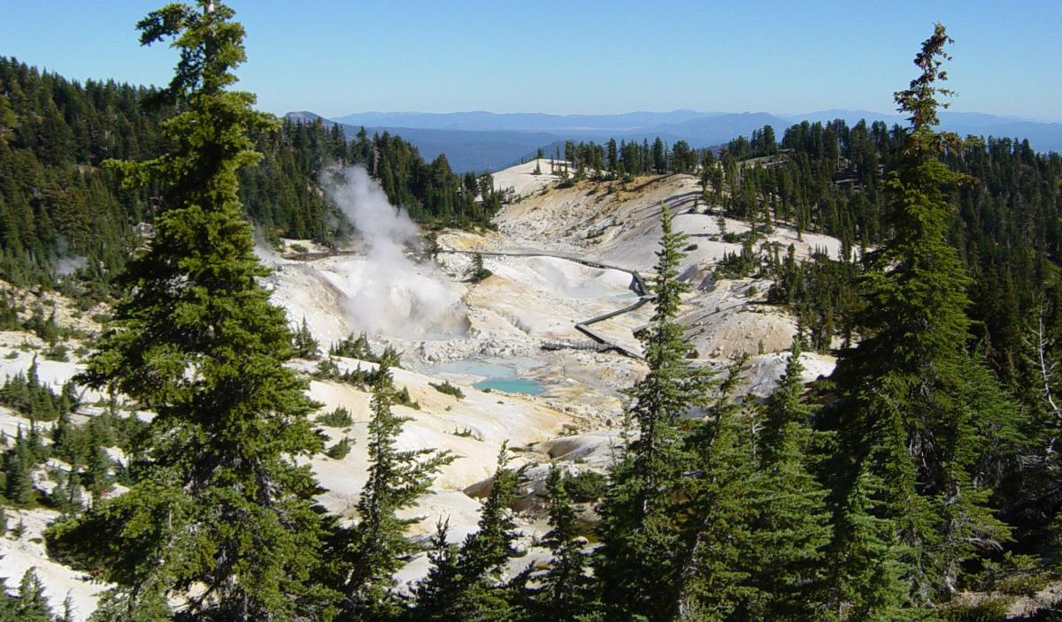
Bumpass Hell
Notes:
Bumpass Hell is Lassen's most spectacular and diversified hydrothermal area with hot springs, mud pots, fumaroles, and mud volcanoes.

Slide 24
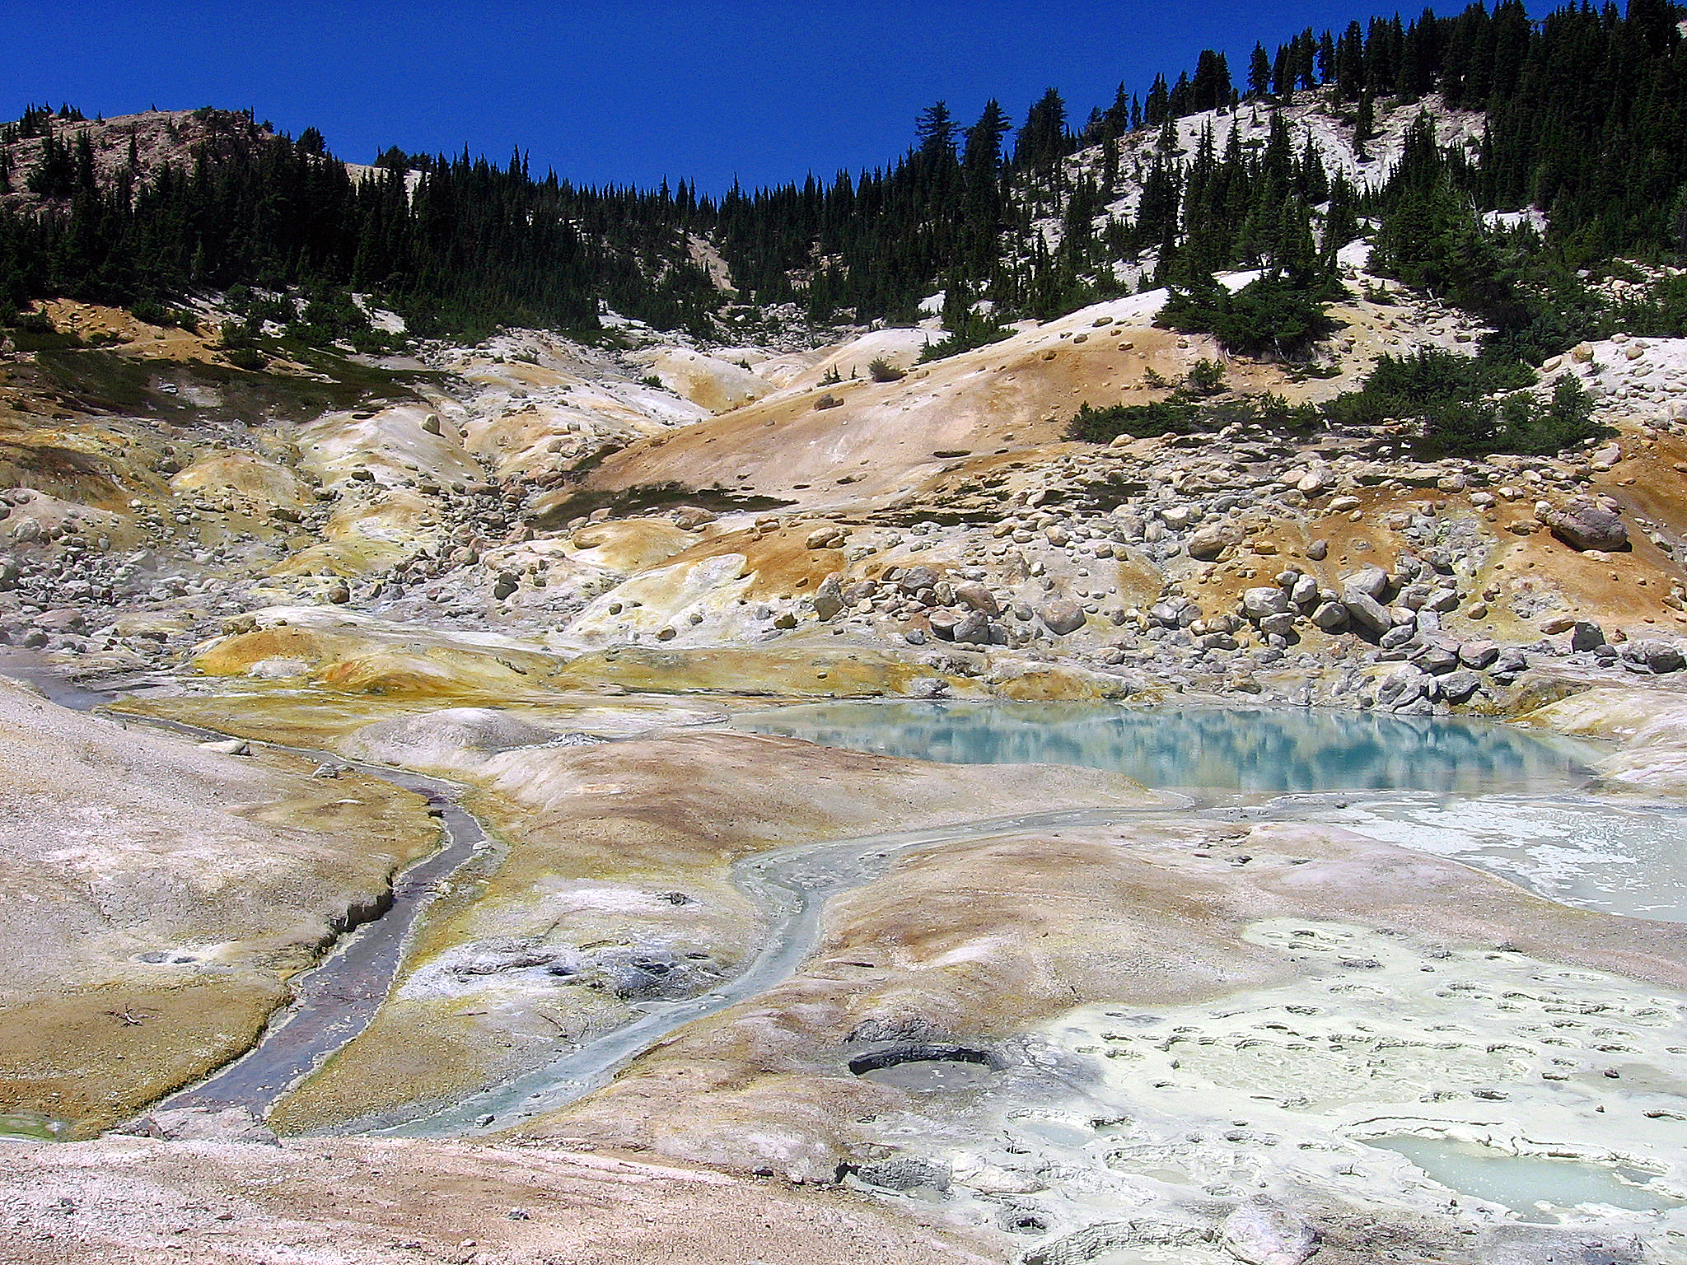
Bumpass Hell
Notes:
The name derives from the misfortune of Kendall Bumpass, a cowboy who stumbled upon the area in the 1860’s and had his leg badly scalded when it broke though a thin crust above a mud pot. He told his friends and townspeople about it, describing it as "hell." A newspaper editor was interested in the story and convinced Bumpass to take him to this place. Unfortunately, Bumpass' leg broke through the crust again, but this time it had to be amputated.

Slide 25
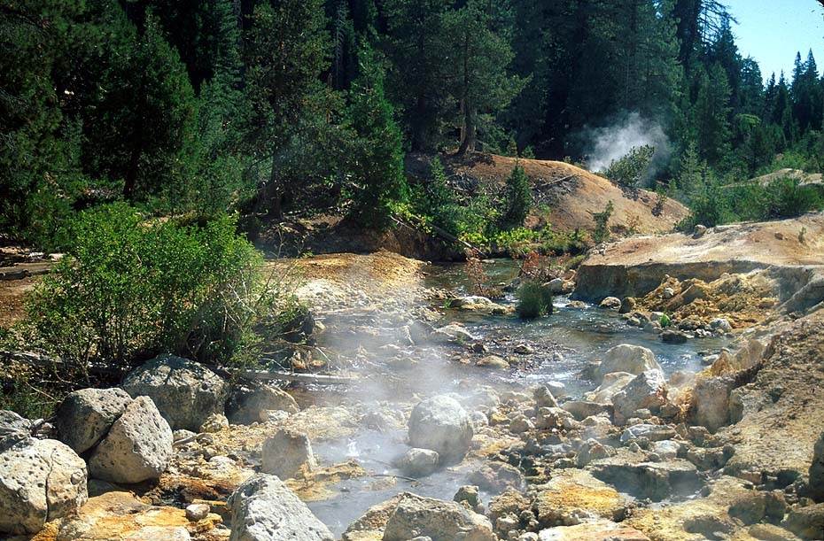
Devil’s Kitchen
Notes:
About seven miles (11 km) southeast of Lassen Peak is Devils Kitchen. In this geothermal area the hot springs are so acidic that they have eaten pits and holes in the bedrock. Devils Kitchen continues a long-standing American tradition to name geologic features after elements of underworld mythology.

Slide 26
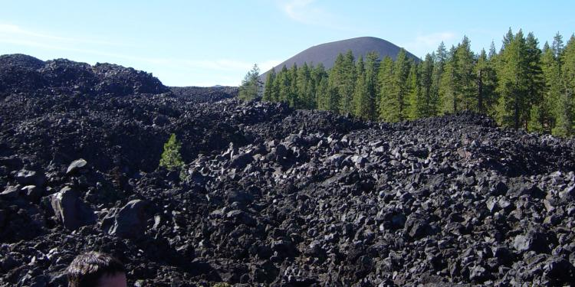

Slide 27
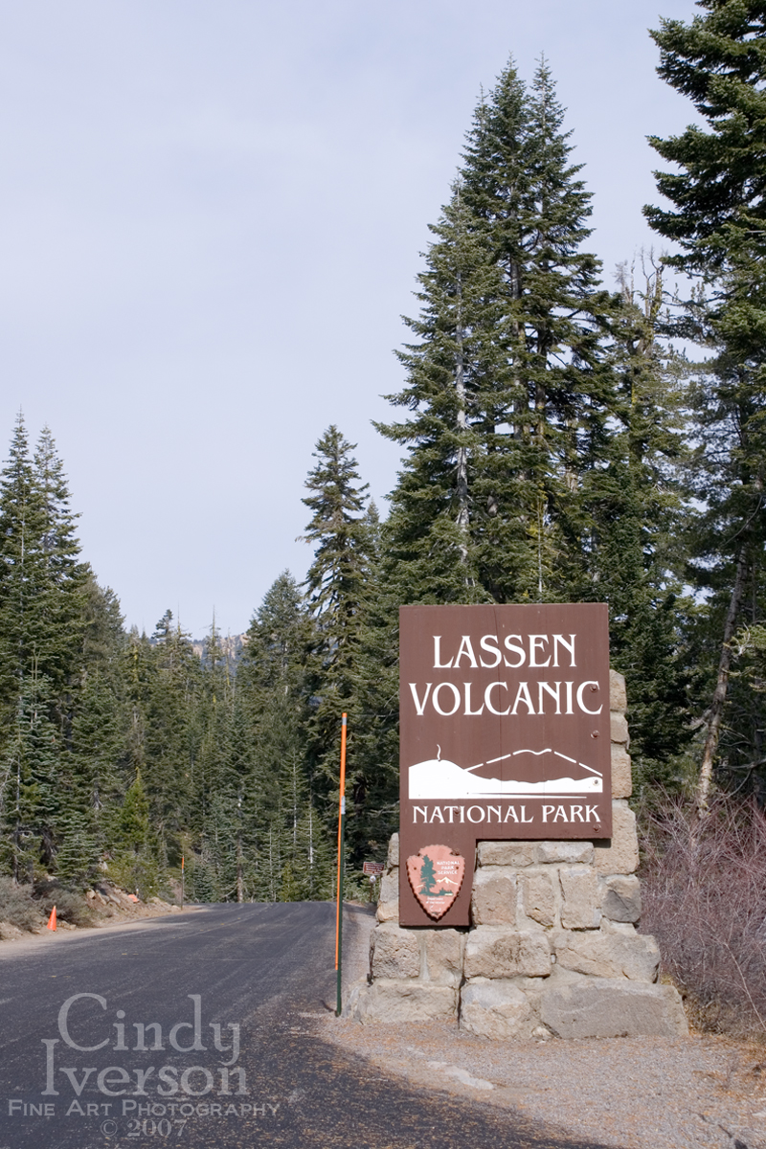
Notes:
The most recent eruptive activity occurred at Lassen Peak in 1914-1917. This eruptive episode began on May 30, 1914, when a small phreatic eruption occurred at a new vent near the summit of the peak. More than 150 explosions of various sizes occurred during the following year. By mid-May 1915, the eruption changed in character; lava appeared in the summit crater and subsequently flowed about 100 m over the west and probably over the east crater walls. Disruption of the sticky lava on the upper east side of Lassen Peak on May 19 resulted in an avalanche of hot rock onto a snowfield. A lahar was generated that reached more than 18 km down Lost Creek. Intermittent eruptions of variable intensity continued until about the middle of 1917.

Slide 28
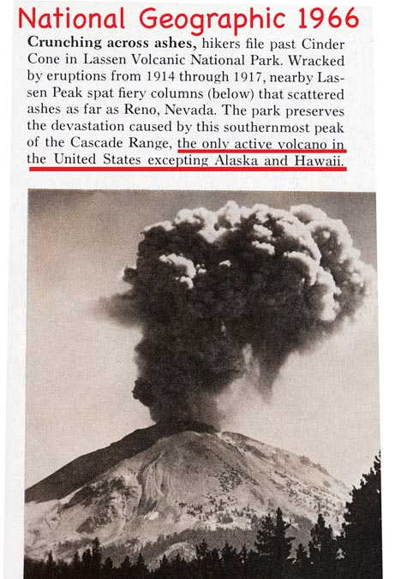

Slide 29
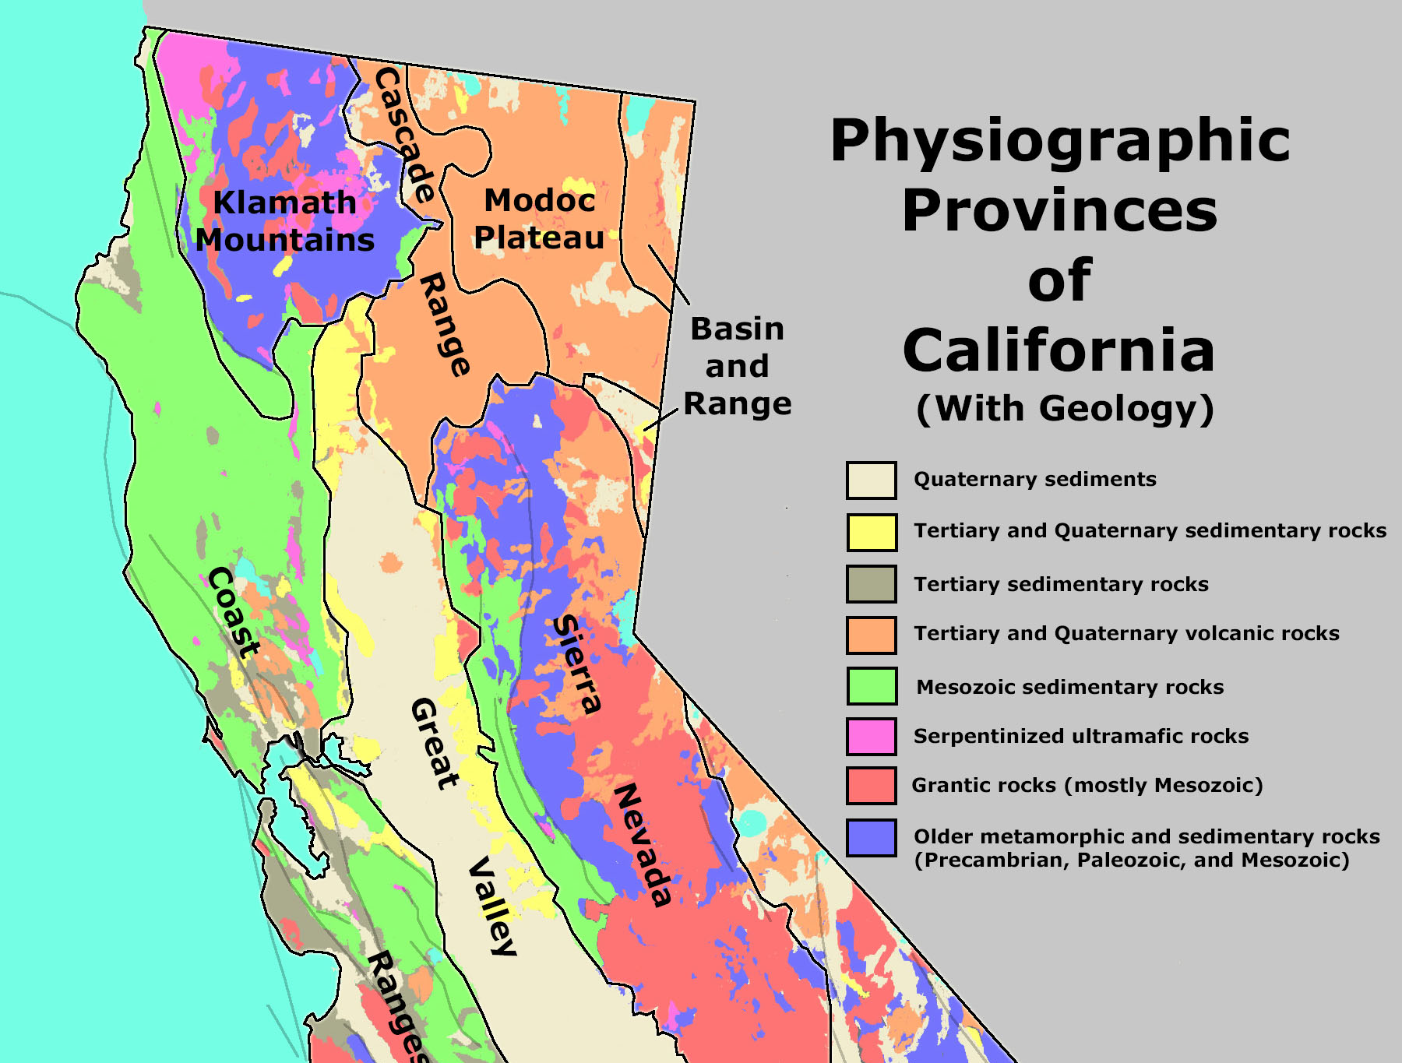

Slide 30
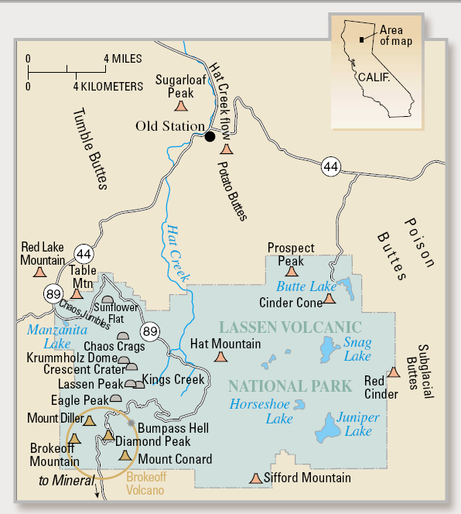
Notes:
Containing multiple examples of the four fundamental types of volcanoes, Lassen Volcanic National Park is aptly named.

Slide 31
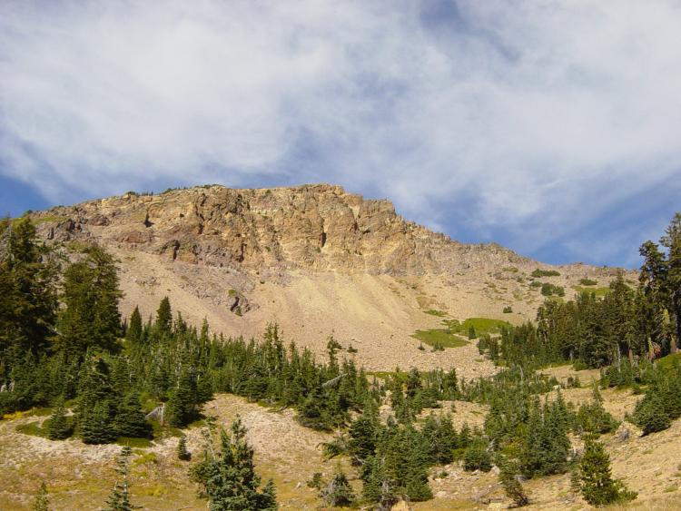
Notes:
Broken face of Brokeoff Mountain

Slide 32
Lake Helen
Notes:
Lake Helen is only one of several cirques around Lassen Pea.

Slide 33
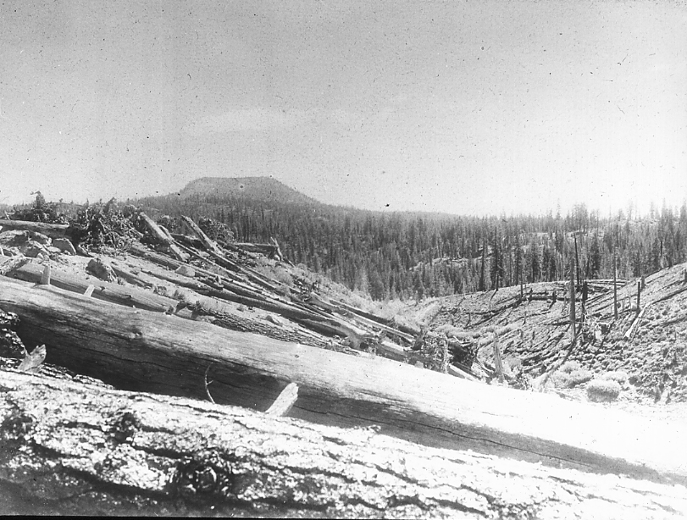
Notes:
Lassen Peak, Cal. Trees leveled in the path of the blast. If they had been covered by ash, in ground water zone, might have been petrified.

Slide 34
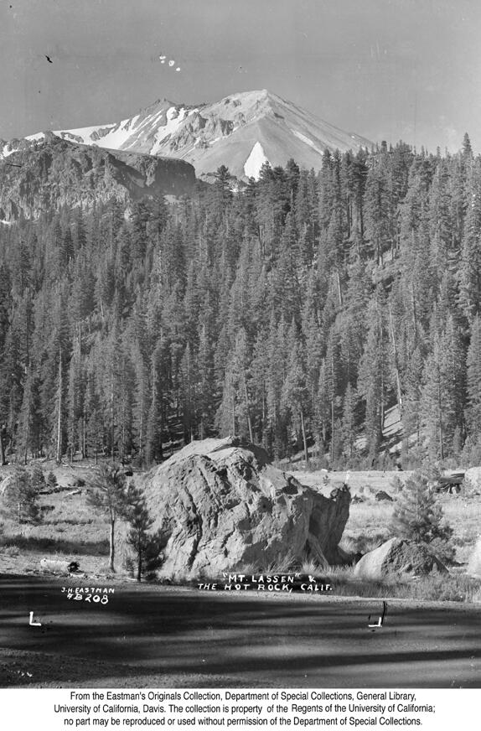

Slide 35
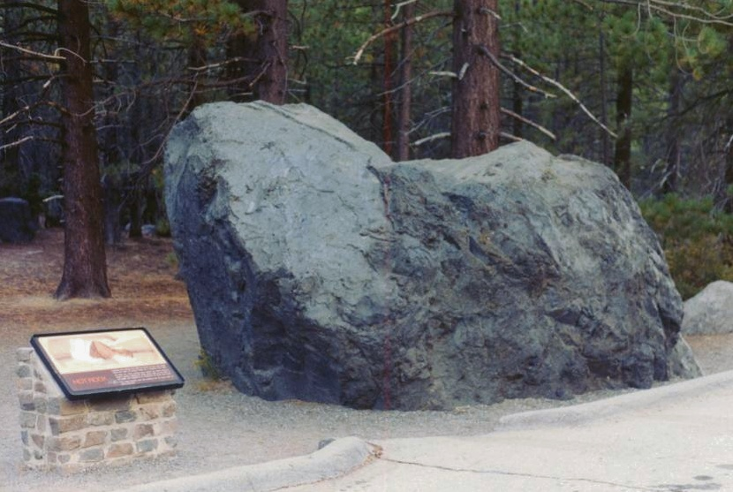

Slide 36
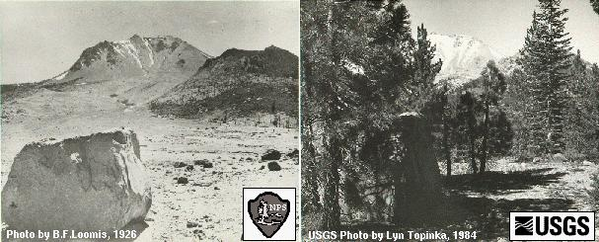
Lassen Peak Recent Volcanic Activity
1926
1984
1926
1984

Slide 37
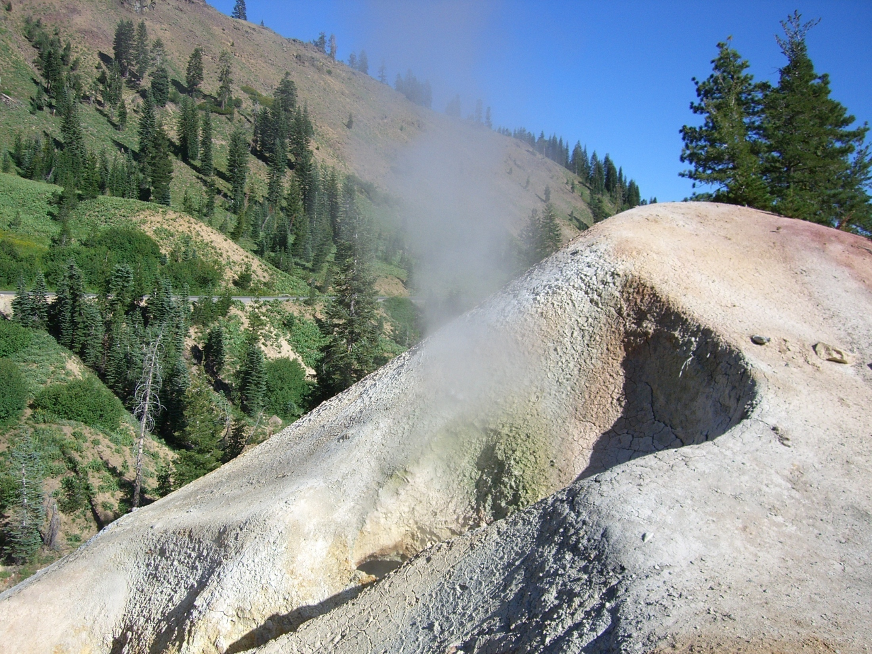
Notes:
The name Sulphur Works was first used in 1865, when efforts were made to develop the sulfur and clay potential of the area.

